Slide 1

Recursion
© 2013 Goodrich, Tamassia, Goldwasser
Recursion
Notes:
Sequences

Slide 2
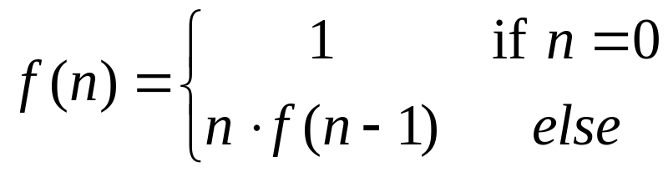
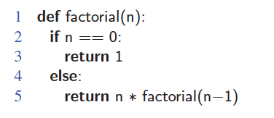
The Recursion Pattern
Recursion: when a method calls itself
Classic example--the factorial function:
  n! = 1· 2· 3· ··· · (n-1)· n
Recursive definition:
As a Python method:
© 2013 Goodrich, Tamassia, Goldwasser
Recursion

Slide 3
Content of a Recursive Method
Base case(s)
  Values of the input variables for which we perform no recursive calls are called base cases (there should be at least one base case).
  Every possible chain of recursive calls must eventually reach a base case.
Recursive calls
  Calls to the current method.
  Each recursive call should be defined so that it makes progress towards a base case.
Recursion
© 2013 Goodrich, Tamassia, Goldwasser

Slide 4
Visualizing Recursion
Example
Recursion trace
  A box for each recursive call
  An arrow from each caller to callee
  An arrow from each callee to caller showing return value
call
return
4
*
6
=
24
final answer
recursiveFactorial
(
4
)
call
return
3
*
2
=
6
recursiveFactorial
(
3
)
call
return
2
*
1
=
2
recursiveFactorial
(
2
)
call
return
1
*
1
=
1
recursiveFactorial
(
1
)
call
return
1
recursiveFactorial
(
0
)
Recursion
© 2013 Goodrich, Tamassia, Goldwasser

Slide 5
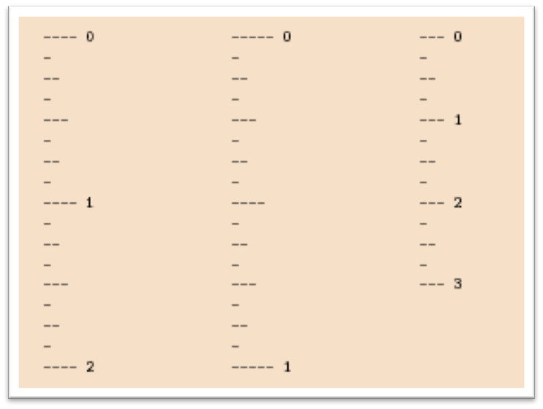
Example: English Ruler
Print the ticks and numbers like an English ruler:
Recursion
© 2013 Goodrich, Tamassia, Goldwasser

Slide 6
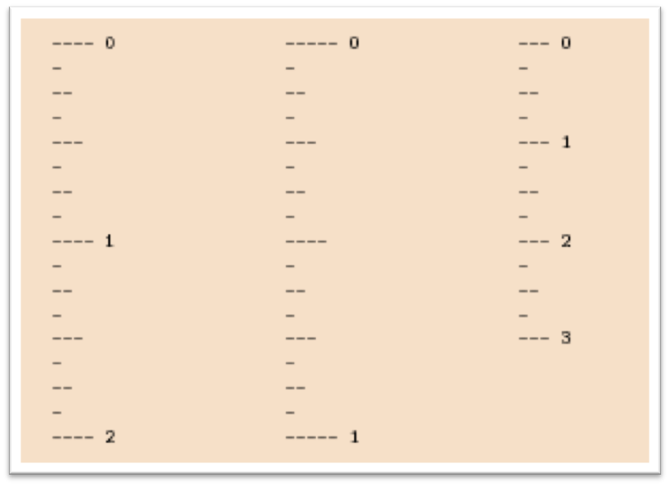
Using Recursion
Slide by Matt Stallmann included with permission.
drawTicks(length)
    Input: length of a ‘tick’
    Output: ruler with tick of the given length in the middle and smaller rulers on either side
drawTicks(length)
if( length > 0 ) then
drawTicks( length − 1 )
draw tick of the given length
drawTicks( length − 1 )
© 2013 Goodrich, Tamassia, Goldwasser
Recursion

Slide 7
Recursive Drawing Method
The drawing method is based on the following recursive definition
An interval with a central tick length L >1 consists of:
  An interval with a central tick length L−1
  An single tick of length L
  An interval with a central tick length L−1
drawTicks
(
3
)
Output
drawTicks
(
2
)
drawTicks
(
1
)
drawTicks
(
0
)
drawOneTick
(
1
)
drawTicks
(
0
)
drawOneTick
(
2
)
drawTicks
(
1
)
drawTicks
(
0
)
drawOneTick
(
1
)
drawTicks
(
0
)
drawOneTick
(
3
)
drawTicks
(
2
)
(
previous pattern repeats
)
Recursion
© 2013 Goodrich, Tamassia, Goldwasser

Slide 8
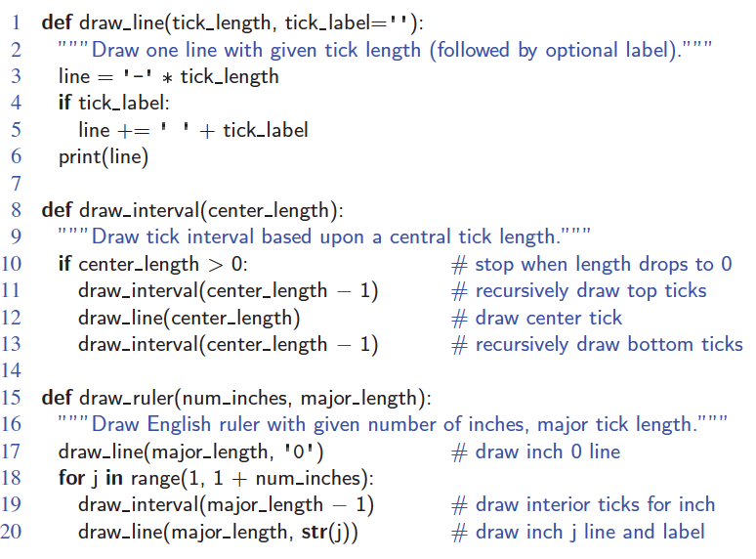
A Recursive Method for Drawing Ticks on an English Ruler
Note the two recursive calls
© 2013 Goodrich, Tamassia, Goldwasser
Recursion

Slide 9
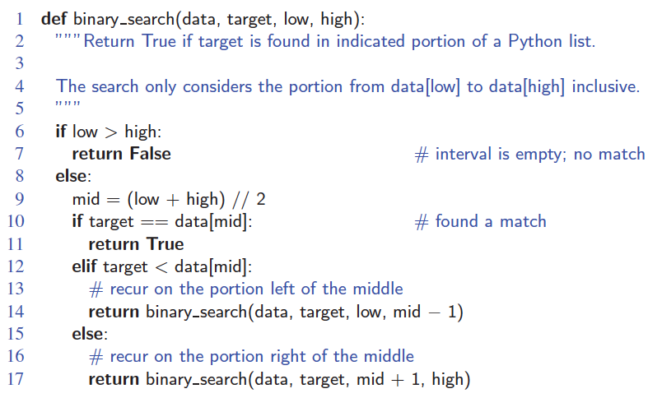
Binary Search
Search for an integer, target, in an ordered list.
© 2013 Goodrich, Tamassia, Goldwasser
Recursion

Slide 10
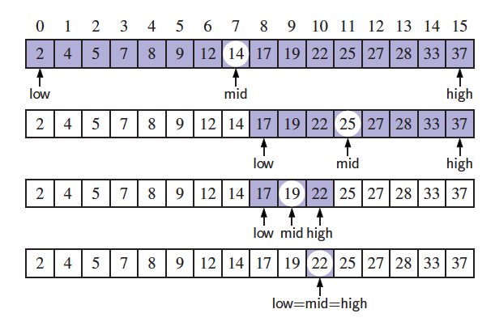
Visualizing Binary Search
We consider three cases:
  If the target equals data[mid], then we have found the target.
  If target < data[mid], then we recur on the first half of the sequence.
  If target > data[mid], then we recur on the second half of the sequence.
© 2013 Goodrich, Tamassia, Goldwasser
Recursion

Slide 11
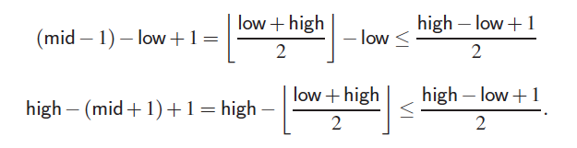
Analyzing Binary Search
Runs in O(log n) time.
  The remaining portion of the list is of size high – low + 1.
  After one comparison, this becomes one of the following:
  Thus, each recursive call divides the search region in half; hence, there can be at most log n levels.
© 2013 Goodrich, Tamassia, Goldwasser
Recursion

Slide 12
Linear Recursion
Test for base cases
  Begin by testing for a set of base cases (there should be at least one).
  Every possible chain of recursive calls must eventually reach a base case, and the handling of each base case should not use recursion.
Recur once
  Perform a single recursive call
  This step may have a test that decides which of several possible recursive calls to make, but it should ultimately make just one of these calls
  Define each possible recursive call so that it makes progress towards a base case.
© 2013 Goodrich, Tamassia, Goldwasser
Recursion

Slide 13
Example of Linear Recursion
Example recursion trace:
Algorithm LinearSum(A, n):
Input:
A integer array A and an integer n = 1, such that A has at least n elements
Output:
The sum of the first n integers in A
if n = 1 then
return A[0]
else
return LinearSum(A, n - 1) + A[n - 1]
call
return
15
+
A
[
4
] =
15
+
5
=
20
LinearSum
(
A
,
5
)
call
return
13
+
A
[
3
] =
13
+
2
=
15
LinearSum
(
A
,
4
)
call
return
7
+
A
[
2
] =
7
+
6
=
13
LinearSum
(
A
,
3
)
call
return
4
+
A
[
1
] =
4
+
3
=
7
LinearSum
(
A
,
2
)
call
return
A
[
0
] =
4
LinearSum
(
A
,
1
)
© 2013 Goodrich, Tamassia, Goldwasser
Recursion

Slide 14
Reversing an Array
Algorithm ReverseArray(A, i, j):
Input: An array A and nonnegative integer indices i and j
Output: The reversal of the elements in A starting at index i and ending at j
if i < j then
Swap A[i] and A[ j]
ReverseArray(A, i + 1, j - 1)
return
© 2013 Goodrich, Tamassia, Goldwasser
Recursion

Slide 15
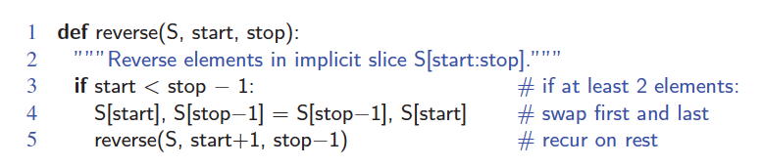
Defining Arguments for Recursion
In creating recursive methods, it is important to define the methods in ways that facilitate recursion.
This sometimes requires we define additional paramaters that are passed to the method.
For example, we defined the array reversal method as ReverseArray(A, i, j), not ReverseArray(A).
Python version:
© 2013 Goodrich, Tamassia, Goldwasser
Recursion

Slide 16
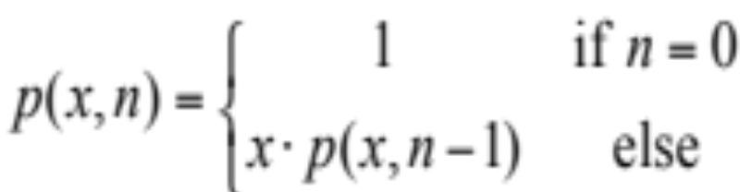
Computing Powers
The power function, p(x,n)=x^{n}, can be defined recursively:
This leads to an power function that runs in O(n) time (for we make n recursive calls).
We can do better than this, however.
© 2013 Goodrich, Tamassia, Goldwasser
Recursion

Slide 17
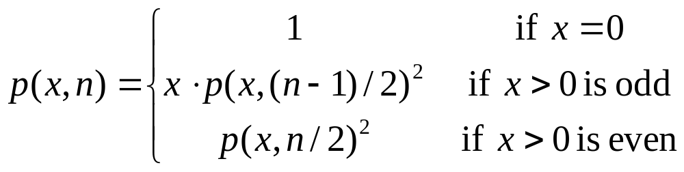
Recursive Squaring
We can derive a more efficient linearly recursive algorithm by using repeated squaring:
For example,
  2⁴ = 2^{(4/2)2} = (2^{4/2})² = (2²)² = 4² = 16
  2⁵ = 2^{1+(4/2)2} = 2(2^{4/2})² = 2(2²)² = 2(4²) = 32
  2⁶ = 2^{(6/ 2)2} = (2^{6/2})² = (2³)² = 8² = 64
  2⁷ = 2^{1+(6/2)2} = 2(2^{6/2})² = 2(2³)² = 2(8²) = 128.
© 2013 Goodrich, Tamassia, Goldwasser
Recursion

Slide 18
Recursive Squaring Method
Algorithm Power(x, n):
Input: A number x and integer n = 0
Output: The value x^{n}
if n = 0 then
return 1
if n is odd then
y = Power(x, (n - 1)/ 2)
return x · y ·y
else
y = Power(x, n/ 2)
return y · y
© 2013 Goodrich, Tamassia, Goldwasser
Recursion

Slide 19
Analysis
Algorithm Power(x, n):
Input: A number x and integer n = 0
Output: The value x^{n}
if n = 0 then
return 1
if n is odd then
y = Power(x, (n - 1)/ 2)
return x · y · y
else
y = Power(x, n/ 2)
return y · y
Each time we make a recursive call we halve the value of n; hence, we make log n recursive calls. That is, this method runs in O(log n) time.
It is important that we use a variable twice here rather than calling the method twice.
© 2013 Goodrich, Tamassia, Goldwasser
Recursion

Slide 20
Tail Recursion
Tail recursion occurs when a linearly recursive method makes its recursive call as its last step.
The array reversal method is an example.
Such methods can be easily converted to non-recursive methods (which saves on some resources).
Example:
  Algorithm IterativeReverseArray(A, i, j ):
  Input: An array A and nonnegative integer indices i and j
  Output: The reversal of the elements in A starting at index i and ending at j
  while i < j do
    Swap A[i ] and A[ j ]
    i = i + 1
    j = j - 1
  return
© 2013 Goodrich, Tamassia, Goldwasser
Recursion

Slide 21
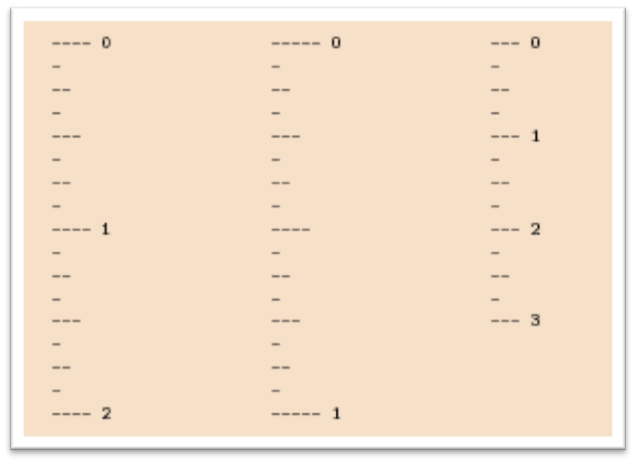
Binary Recursion
Binary recursion occurs whenever there are two recursive calls for each non-base case.
Example from before: the DrawTicks method for drawing ticks on an English ruler.
© 2013 Goodrich, Tamassia, Goldwasser
Recursion

Slide 22
Another Binary Recusive Method
Problem: add all the numbers in an integer array A:
  Algorithm BinarySum(A, i, n):
  Input: An array A and integers i and n
  Output: The sum of the n integers in A starting at index i
  if n = 1 then
  return A[i ]
  return BinarySum(A, i, n/ 2) + BinarySum(A, i + n/ 2, n/ 2)
Example trace:
0
,
8
0
,
4
4
,
4
0
,
2
2
,
2
4
,
2
6
,
2
0
,
1
1
,
1
2
,
1
3
,
1
4
,
1
5
,
1
6
,
1
7
,
1
© 2013 Goodrich, Tamassia, Goldwasser
Recursion

Slide 23
Computing Fibonacci Numbers
Fibonacci numbers are defined recursively:
    F₀ = 0
    F₁ = 1
    F_{i} = F_{i-1} ⁺ F_{i-2} for i > 1.
Recursive algorithm (first attempt):
      Algorithm BinaryFib(k):
      Input: Nonnegative integer k
      Output: The kth Fibonacci number F_{k}
      if k = 1 then
      return k
      else
      return BinaryFib(k - 1) + BinaryFib(k - 2)
© 2013 Goodrich, Tamassia, Goldwasser
Recursion

Slide 24
Analysis
Let n_{k} be the number of recursive calls by BinaryFib(k)
  n₀ = 1
  n₁ = 1
  n₂ = n₁ + n₀ + 1 = 1 + 1 + 1 = 3
  n₃ = n₂ + n₁ + 1 = 3 + 1 + 1 = 5
  n₄ = n₃ + n₂ + 1 = 5 + 3 + 1 = 9
  n₅ = n₄ + n₃ + 1 = 9 + 5 + 1 = 15
  n₆ = n₅ + n₄ + 1 = 15 + 9 + 1 = 25
  n₇ = n₆ + n₅ + 1 = 25 + 15 + 1 = 41
  n₈ = n₇ + n₆ + 1 = 41 + 25 + 1 = 67.
Note that n_{k} at least doubles every other time
That is, n_{k} > 2^{k/2}. It is exponential!
© 2013 Goodrich, Tamassia, Goldwasser
Recursion

Slide 25
A Better Fibonacci Algorithm
Use linear recursion instead
    Algorithm LinearFibonacci(k):
    Input: A nonnegative integer k
    Output: Pair of Fibonacci numbers (F_{k} , F_{k−1})
    if k = 1 then
    return (k, 0)
    else
    (i, j) = LinearFibonacci(k − 1)
    return (i +j, i)
LinearFibonacci makes k−1 recursive calls
© 2013 Goodrich, Tamassia, Goldwasser
Recursion

Slide 26
Multiple Recursion
Motivating example:
  summation puzzles
    pot + pan = bib
    dog + cat = pig
    boy + girl = baby
Multiple recursion:
  makes potentially many recursive calls
  not just one or two
© 2013 Goodrich, Tamassia, Goldwasser
Recursion

Slide 27
Algorithm for Multiple Recursion
Algorithm PuzzleSolve(k,S,U):
Input: Integer k, sequence S, and set U (universe of elements to test)
Output: Enumeration of all k-length extensions to S using elements in U without repetitions
for all e in U do
Remove e from U {e is now being used}
Add e to the end of S
if k = 1 then
Test whether S is a configuration that solves the puzzle
if S solves the puzzle then
return “Solution found: ” S
else
PuzzleSolve(k - 1, S,U)
Add e back to U {e is now unused}
Remove e from the end of S
© 2013 Goodrich, Tamassia, Goldwasser
Recursion

Slide 28
Example
Slide by Matt Stallmann included with permission.
cbb + ba = abc
a,b,c stand for 7,8,9; not necessarily in that order
799 + 98 = 997
[] {a,b,c}
[a] {b,c}
a=7
[b] {a,c}
b=7
[c] {a,b}
c=7
[ab] {c}
a=7,b=8
c=9
[ac] {b}
a=7,c=8
b=9
[ca] {b}
c=7,a=8
b=9
[cb] {a}
c=7,b=8
a=9
[ba] {c}
b=7,a=8
c=9
[bc] {a}
b=7,c=8
a=9
might be able to
stop sooner
© 2013 Goodrich, Tamassia, Goldwasser
Recursion

Slide 29
Visualizing PuzzleSolve
Initial call
PuzzleSolve
(
3
,
()
,{
a
,
b
,
c
}
)
PuzzleSolve
(
2
,
a
,{
b
,
c
}
)
PuzzleSolve
(
2
,
b
,{
a
,
c
}
)
PuzzleSolve
(
2
,
c
,{
a
,
b
}
)
PuzzleSolve
(
1
,
ab
,{
c
}
)
PuzzleSolve
(
1
,
ba
,{
c
}
)
PuzzleSolve
(
1
,
ca
,{
b
}
)
abc
bac
cab
PuzzleSolve
(
1
,
ac
,{
b
}
)
PuzzleSolve
(
1
,
bc
,{
a
}
)
PuzzleSolve
(
1
,
cb
,{
a
}
)
acb
bca
cba
© 2013 Goodrich, Tamassia, Goldwasser
Recursion

